Slide 1

RECOMMENDATION FOR A MOVIE STUDIO
Julia Müller

Slide 2
Agenda
Context & Background
Insights
Recommendation
Caveats
Questions & Answer

Slide 3
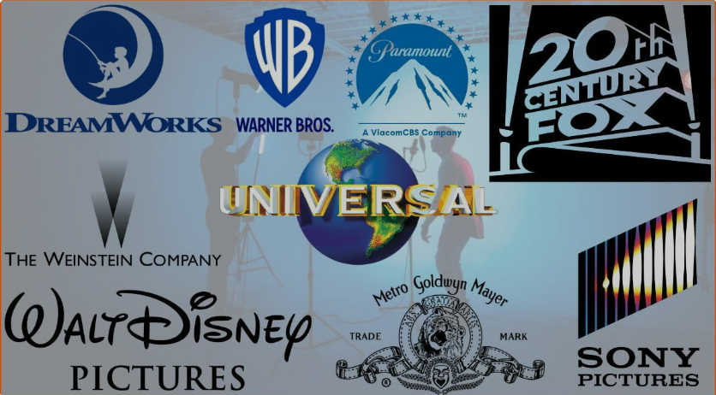
CONTEXT AND BACKGROUND
>10.000 movie studios in the world
Hollywood is still most dominant location
Warner Bros. is number one movie studio → box office $46.882 billion and 279 movies produced
In the last decade, streaming services are entering the market and movie studios are under more pressure than before

Slide 4
What should Microsoft keep in mind when creating your very own movie studio?
Which movie studios & directors are the best?
Which genres are the most successful?
How long should a movie run?

Slide 5




Data Sources
Director
Movie Rating
Runtime
Studio
Box Office
Production Budget
Worldwide Gross
Genres

Slide 6
Highest grossing movie studios (Box Office Mojo)
From 2010 – 2018 Buena Vista studio had the highest absolute gross*
With around 80 movies, they grossed more than 35 billion USD.
Buena Vista are known for their animated, family movies and Action/Adventure/Sci-Fi movies such as Black Panther or Avengers
*limited data available (only ~300 titles per year)

Slide 7
TOP 10 DIRECTORS FOR HIGH ROI AND EARNINGS (IMDB)
Kyle Balda (Minions, Despicable Me) is a recommendation for Animation genre. Comparably low investment and highest ROI (>1400%). Same applies for Yarrow Cheney.
For Anthony Russo (Avengers – Infinity War) who has the highest gross, the investment is also comparably high (>200 Mio USD)

Slide 8
Animation, Adventure and Sci-Fi movies generate the highest earnings
On average, the animation genre* creates the highest earnings, closely followed by Adventure and Sci-Fi.
Next group is Action, Fantasy and Family
Documentaries are the lowest genre in terms of earnings
Ratings and earnings of a movie only have a weak correlation (.25) → other factors seem to be more important than the rated quality of the movie.
*only genres included with more than 30 movies

Slide 9
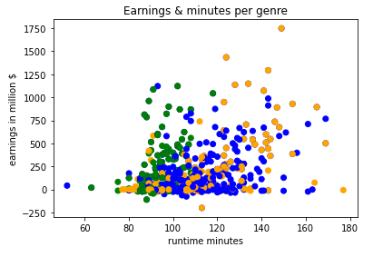
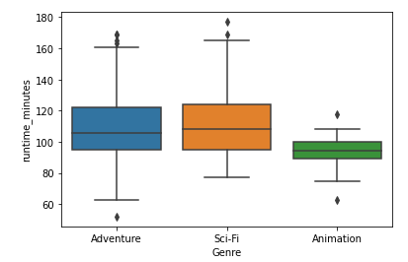
Is the runtime important for the success of a movie?

